Slide 1

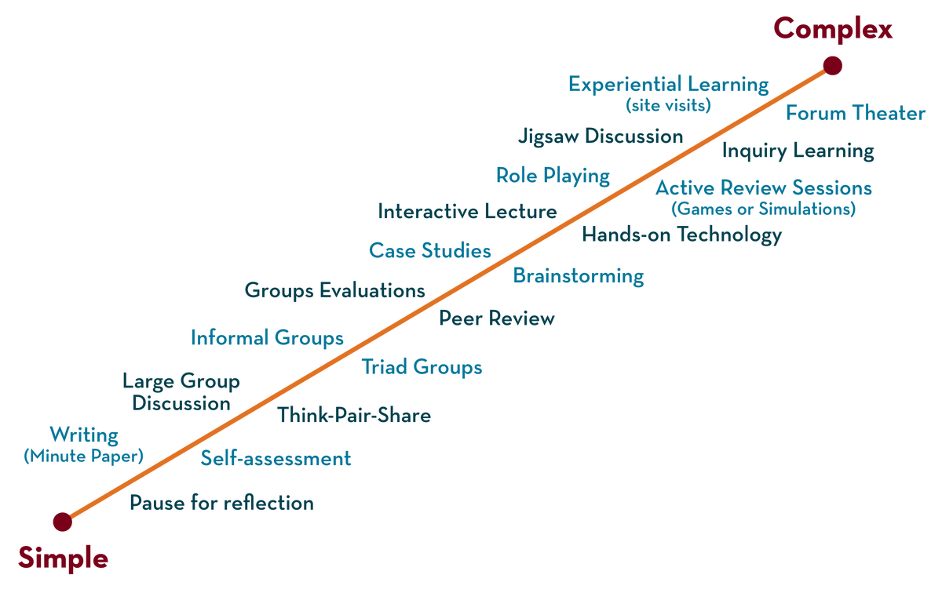
Department of CSE
Deep Learning
20CS3269AA
Topic:
Challenges in Neural Network Optimization
&
Gradien descent
Session - 6

Slide 2



AIM OF THE SESSION
To familiarize students with the challenges in optimization and the concept of Gradient Descent (GD)
INSTRUCTIONAL OBJECTIVES
This Session is designed to:
Challenges in in neural network optimization
Demonstrate the Gradient Descent (GD)
LEARNING OUTCOMES
At the end of this session, you should be able to:
Able to apply Gradient Descent (GD) for optimization

Slide 3
SESSION INTRODUCTION
The topics covered in the session are
Challenges in Neural Network Optimization
What is Gradient Descent (GD)
Gradient Descent (GD) algorithm
Problem on GD

Slide 4
SESSION DESCRIPTION

Slide 5
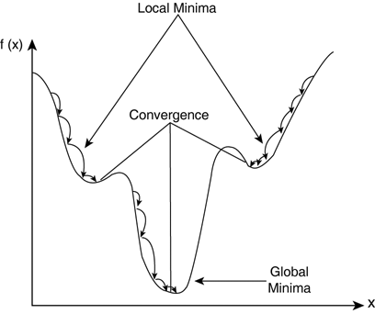
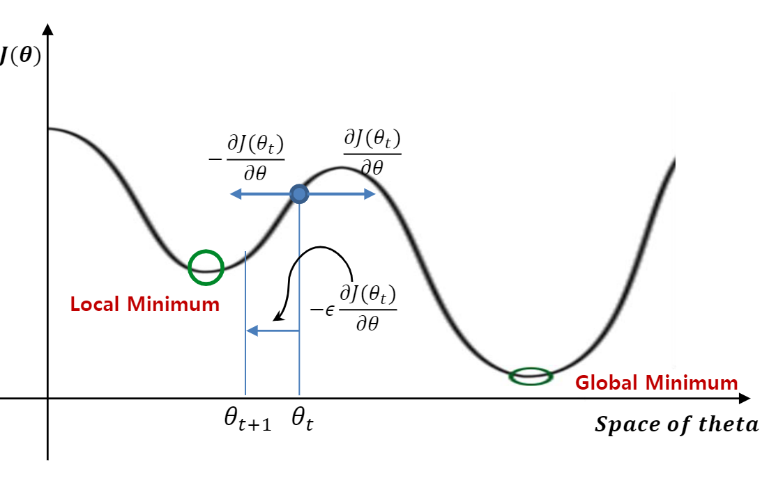
Challenges in Neural Network Optimization
1. Local minima: Generally any DL model is guaranteed to have an extremely large number of local minima (LM) arising due to the model identifiability problem
Notes:
For any objective function f(x), if the value of f(x) at x is smaller than the values of f(x) at any other points in the vicinity of x, then f(x) could be a local minimum. If the value of f(x) at x is the minimum of the objective function over the entire domain, then f(x) is the global minimum.

Slide 6
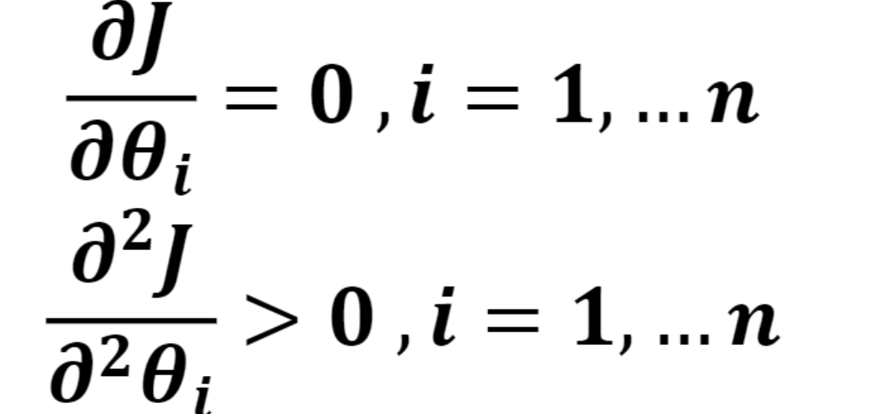
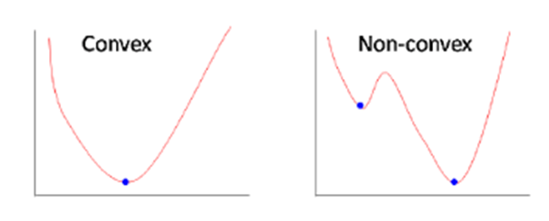
Local minima ….
For any objective function f(x), if the value of f(x) at x is smaller than the values of f(x) at any other points in the vicinity of x, then f(x) could be a local minimum
For many high dimensional con-convex functions local minima’s are very rare cases. Because local minima should satisfy .

Slide 7
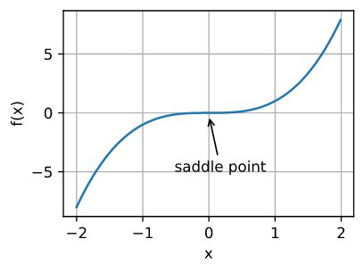
Challenges in Neural Network Optimization …
2. Plateaus, Saddle Points and Other Flat Regions:
Saddle point (SP) is another type of point with zero gradient where some points around it have higher value and the others have lower.
A saddle point is any location where all gradients of a function vanish but which is neither a global nor a local minimum.

Slide 8
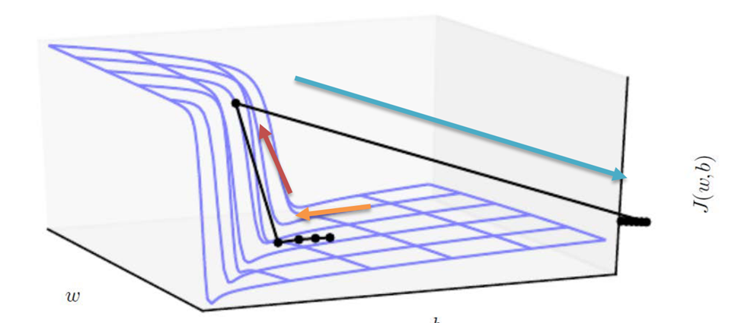
Challenges in Neural Network Optimization……
3.Cliffs and Exploding Gradients:
NNs might sometimes have extremely steep regions resembling cliffs due to the repeated multiplication of weights.
At the edge of such a cliff, an update step might throw the parameters extremely far. It can be taken care of by using gradient clipping (GC).
The gradient indicates only the direction in which to make the update. If the GD update proposes making a very large step, GC intervenes to reduce the step size.
If gradient update step can move the parameter extremely far is an exploring gradient problem

Slide 9
Challenges in Neural Network Optimization …
4. ill-conditioning
The ill-conditioning problem is generally believed to be present in neural network training problems.
Ill-conditioning can manifest by causing SGD to get “stuck” in the sense that even very small steps increase the cost function.
Ill condition occurs when this condition is true
Where g is first order gradient and H is second order derivative or Hessian matrix

Slide 10
Identifiers for Ill-conditioning
Loss values do not seem to decrease. This could mean that the loss function performs larger updates which leads the gradient to bounce around in the function.
Sometimes NaN values can be observed in the loss values. One explanation for this is that the loss values could have exploded due to larger learning rates or larger weights. In addition to ill-conditioning, this can also be an indicator for exploding gradients problem.

Slide 11
Learning rate
What is learning rate?
Learning rate (alpha) is a hyper-parameter used to control the rate at which an algorithm updates the parameter estimates or learns the values of the parameters.
It is used to scale the magnitude of parameter updates during gradient descent.
Learning rate is a scalar, a value that tells the machine how fast or how slow to arrive at some conclusion.
Effect of small and large learning rates
If the learning rate (alpha) is too small, learning will take so long to converge
if the learning rate is too large, during learning, it may miss to converge.

Slide 12
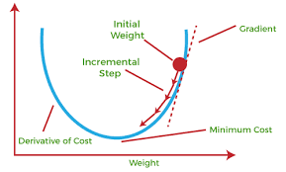
What is gradient decent
Gradient descent is an optimization algorithm
It is utilized to minimize the cost function used in various machine learning/Deep learning algorithms to update the parameters of the learning model.
In linear regression, these parameters are coefficients, and in the neural network, they are weights and bias.
Steps should be made in proportion to the negative of the function gradient (move away from
the gradient) at the current point to find local minima.
Gradient Ascent is the procedure for approaching
a local maximum of a function by taking steps proportional
to the positive of the gradient (moving towards
the gradient).

Slide 13
Gradient decent algorithm
repeat until convergence
{
w = w - (learning_rate * (dJ/dw))
b = b - (learning_rate * (dJ/db))
}

Slide 14
Parameters -
To implement a gradient descent algorithm we require
a cost function that needs to be minimized,
the number of iterations,
a learning rate to determine
the step size at each iteration while moving towards the minimum
partial derivates for weight & bias to update the parameters at each iteration and a prediction function.

Slide 15
Comparison Perceptron and Gradient Descent Rule
Perceptron learning rule guaranteed to succeed if
Training examples are linearly separable
Sufficiently small learning rate η
Linear unit training rules uses gradient descent
Guaranteed to converge to hypothesis with minimum squared error
Given sufficiently small learning rate η
Even when training data contains noise
Even when training data not separable by H

Slide 16
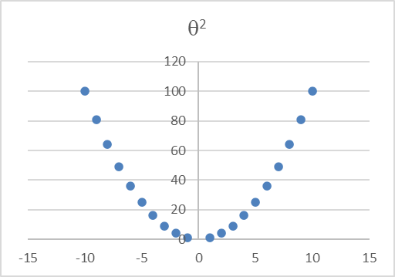
Example
Gradient function is θ²
Find the local minima of this function
Initializing θ as 2
Df/d θ= 2 θ, learning rate = 0.01
perform 4 iterations of gradient descent
Notes:
https://uclaacm.github.io/gradient-descent-visualiser/ x³ is for checking saddle point

Slide 17
Drawbacks of gradient decent
Gradient Descent uses the whole training data to update weight and bias.
Suppose if we have millions of records then training becomes slow and computationally very expensive.

Slide 18
Problem
Consider the following training set of m=4 training examples:
x y
1 0.5
2 1
4 2
0 0
Consider the linear regression model hθ(x)=θ₀+θ₁x. What are the values of θ₀ and θ₁ that you would expect to obtain upon running gradient descent on this model?
Notes:
solution θ₀=0,θ₁=0.5
As J(θ₀,θ₁)=0, y = h_{θ}(x) = θ₀ + θ₁x. Using any two values in the table, solve for θ₀, θ₁.

Slide 19
Type of sampling based algorithms
There are 3 types of sampling based algorithms
- batch gradient descent (BGD) -where the entire training set is used to make a single update,
stochastic gradient descent (SGD) where a single example is used to make an update
and mini-batch gradient descent (MBGD) where a batch (not to be confused with BGD) of examples is randomly sampled from the entire training set and is used to make an update.

Slide 20
Batch Gradient Descent
Batch gradient descent (BGD) is used to find the error for each point in the training set and update the model after evaluating all training examples. This procedure is known as the training epoch. In simple words, it is a greedy approach where we have to sum over all examples for each update.
Advantages of Batch gradient descent:
It produces less noise in comparison to other gradient descent.
It produces stable gradient descent convergence.
It is Computationally efficient as all resources are used for all training samples.

Slide 21
Summary
Optimization process has challenges like
Local minima
Plateaus, Saddle Points and Other Flat Regions
Cliffs and
Exploding Gradients
ill-conditioning
Gradient decent is one of the optimization algorithm

Slide 22
SELF-ASSESSMENT QUESTIONS
True or False : Gradient Descent is an optimisation problem
Which of the following is not the a variant of Gradient Descent
Vanilla
ADAGRAD
ADAM
None of the above
3. Learning rate is a hyper parameter in Gradient Descent used to update the parameters in the optimisation problem True /False

Slide 23
TERMINAL QUESTIONS
Define Gradient Descent?
Solve the second order Gradient decent for the function 4x²+2x+2
If the learning rate is too small, then gradient descent may take a very long time to converge. Justify
4. How do you overcome the optimization challenges in neural network

Slide 24
REFERENCES FOR FURTHER LEARNING OF THE SESSION
Books:
1 Ian Goodfellow and Yoshua Bengio and Aaron Courville (2016) Deep Learning Book
Sites and Web links:
https://shanzhenren.github.io/csci-699-replnlp-2019fall/lectures/W4-L1-Training_DNNs_I.pdf
https://medium.com/inveterate-learner/deep-learning-book-chapter-8-optimization-for-training-deep-models-part-ii-438fb4f6d135

